Slide 1
TCP/IP Network Fundamentals
UEEN2013/UEEN2432
(Topic 05)
Access Control Lists (ACL)

Slide 2
What is one of the major reasons to do IP subnet?
Answer:
To limit the broadcast domain.
To provide some security in the network.
How (in security)?
Access control list
Packet filtering at the router level
Can block packets based on IP and port numbers.

Slide 3
What is ACL?
ACL = Access List.
essentially a list of conditions that categorize packets.
It is a form of packet filtering in Cisco router.
ACL is used in:
exercising control over network traffic.
filtering unwanted packets when implementing security policies.

Slide 4
“Applying” ACLs
There are two steps for applying ACL:
1st step:
Create the Access Control List
2nd step:
Place the Access Control List at the Interface
There 3 types of ACL:
Standard Access List
Extended Access List
Named Access List

Slide 5
Syntax of Standard ACLs Explained
Part 3:
Can either be permit or deny
Example:
R1(config)#access-list 10 deny host 192.168.1.1
Part 1:
You must have this to create a
standard ACL
Part 4:
A host
A LAN / IP subnets
Any Host
Source IP/source IP Subnet
Create ACL
in global
configuration
mode
Part 2:
Access list number.
Use 1-99 for
standard ACL.

Slide 6
Introduction to Wildcard Mask
As you’ve observed, a portion of “part 4” in defining the IP subnet in ACL contain:
A wildcard mask: 0.0.0.255
Instead of a subnet mask: 255.255.255.0
For example: An IP subnet of 172.16.1.0 to 172.16.1.255
With subnet mask (in setting static IP route):
R1(config)#ip route 172.16.1.0 255.255.255.0 10.1.1.2
With wildcard mask (in setting access list):
R1(config)#access-list 9 permit 172.16.1.0 0.0.0.255
The first step to know wildcard mask is:
Wildcard mask IS NOT subnet mask.
Wildcard mask DOES NOT HAVE any relation with subnet mask.
Wildcard mask use a different set of rules compared to subnet mask.

Slide 7
Difference Between Subnet mask and Wildcard mask
Unlike subnet mask, wildcard mask:
Does not restrict to left all ‘0’ and right all ‘1’
That means, there can be 2³² wildcard mask
versus only 32 valid subnet mask
Hence, this is allow:
01001000.10001111.11111111.00000001
Does not perform “bitwise and” process with IP address

Slide 8
The ANY and HOST Option
R1(config)#access-list 4 permit 0.0.0.0 255.255.255.255
Can be written as:
R1(config)#access-list 4 permit any
R1(config)#access-list 3 permit 172.16.3.2 0.0.0.0
Can be written as:
R1(config)#access-list 2 permit host 172.16.3.2
There are two special keywords that are used in ACLs, the any and host options.
Simply put, the any option substitutes 0.0.0.0 for the IP address and 255.255.255.255 for the wildcard mask.
This option will match any address that it is compared against.
The host option substitutes for the 0.0.0.0 mask.
This mask requires that all bits of the ACL address and the packet address match. This option will match just one address.

Slide 9
More Rules for Standard ACLs
The “part 4” of Standard ACL works on the source IP address.
1 ACL list represent by 1 ACL number.
You can assign as many “conditions” into a list
Every Standard ACL list has a hidden “deny all” statement at the last of the list.
Use this command to see the access list
Router#show access-list 5
Use this command to erase a access list
Router(config)#no access-list 15

Slide 10
Multi-condition Standard ACL
Router#config t
Router(config)#access-list 5 deny host 172.16.10.1
Router(config)#access-list 5 deny host 172.16.10.2
Router(config)#access-list 5 deny host 172.16.10.3
Router(config)#access-list 5 permit any
Router(config)#access-list 7 deny host 172.16.10.3
Router(config)#access-list 7 deny host 192.168.1.4
Router(config)#access-list 7 permit any
Router(config)#exit
Router#show access-list
Standard IP access list 5
deny host 172.16.10.1
deny host 172.16.10.2
deny host 172.16.10.3
permit any
Standard IP access list 7
deny host 172.16.10.3
deny host 192.168.1.4
permit any

Slide 11

Placing Standard ACLs - 1
Example:
R1(config)#int fa0/0
R1(config-if)#ip access-group 10 in
R1(config-if)#ip access-group 12 out
The ip access-group command links an existing ACL to an interface
Fa0/0 in
Fa0/1 out
Fa0/0 out
Fa0/1 in

Slide 12
Placing Standard ACLs - 2
You can place
same Access List at different interface
only 2 Access List at same interface for both in and out
Router(config)#int fa0/0
Router(config-if)#ip access-group 10 in
Router(config)#int fa0/1
Router(config-if)#ip access-group 10 in
Router(config)#int fa0/0
Router(config-if)#ip access-group 10 in
Router(config-if)#ip access-group 97 out

Slide 13
Checking and Unbind the “Placement” of ACLs
Use the following commands to verify the placement of ACLs on the interfaces of router.
Router#show ip interface
Router#show running-config
Remember to “unbind” an ACL at the interface level by typing the following commands
R1(config)#int fa0/0
R1(config-if)#no ip access-group list_number in

Slide 14
Show running-config
R1#show run
version 12.2
hostname R1
interface FastEthernet0/0
ip address 192.168.14.1 255.255.255.0
ip access-group 23 in
duplex auto
speed auto
!
Show running-config command display the binding or placement of access list on a particular interface.
It is also a good practice to test the access lists with sample traffic to ensure that the access list logic is correct.

Slide 15
Show IP Interface
R1#show ip interface
FastEthernet0/0 is up, line protocol is up (connected)
Internet address is 192.168.14.1/24
Broadcast address is 255.255.255.255
Address determined by setup command
MTU is 1500 bytes
Helper address is not set
Directed broadcast forwarding is disabled
Multicast reserved groups joined: 224.0.0.9
Outgoing access list is not set
Inbound access list is 1
Proxy ARP is enabled
Security level is default
Split horizon is enabled
…
The show ip interface command displays IP interface information and indicates whether any ACLs are set.

Slide 16
While you delete Access List
When you delete a particular ACLs,
Only the content of the ACL is empty
The binding ACLs is still at the interface
Meaning the Interface still has the ACL
Problem occurs if you “unintentionally” re-use the deleted ACL…
Example:
R1(config)#no access-list 2
R1(config)#exit
R1#show run
version 12.2
hostname R1
interface FastEthernet0/0
ip address 192.168.14.1 255.255.255.0
ip access-group 2 in
!

Slide 17
Placing ACL at VTY
Here is an example of allowing only host 172.16.10.3 to telnet into a router:
Lab_A(config)#access-list 50 permit 172.16.10.3
Lab_A(config)#line vty 0 4
Lab_A(config-line)#access-class 50 in
Because of the implied deny any at the end of the list, the access list stops any host from telnetting into the router except the host 172.16.10.3, regardless of which individual IP address on the router is used as a target.
For VTY line, use access-class to bind the ACL
instead of ip access-group for other type of interfaces.

Slide 18
Creating IP Extended List
R1(config)#access-list 114 permit tcp 172.16.6.0 0.0.0.255 any eq telnet
R1(config)#access-list 114 permit tcp 172.16.6.0 0.0.0.255 any eq ftp
R1(config)#access-list 114 permit tcp 172.16.6.0 0.0.0.255 any eq ftp-data
In Extended Access List
We have both source IP and destination IP
We have layer-4 protocols and layer-5 protocols
We have a different access-list number range
Instead of “4 parts” in standard ACL, we have 8 parts in extended ACL
Part 1
Part 2
Part 3
Part 4
Part 5
Part 6
Part 8
Part 7

Slide 19
Extended ACL – Part 1-4
Part 1: The command “access-list”
is still the same.
Part 2: The access-list number
range or extended ACL
is 100 to 199.
Part 3:
deny or permit
Part 4:
Layer 3 protocol
Layer 4 protocol

Slide 20
Extended ACL – Part 5-8
Part 5:
Source address
Host, any, IP subnet
Same as standard ACL
Part 6:
“Normally” Destination address
Part 7
Normally conditional phrase
gt = greater than
eq = equal
lt = less than
neq = not equal
Part 8:
Port numbers
Port number equivalent network service
telnet (port 22)

Slide 21
Extended List Placement
R1(config-if)#ip access-group 110 in
R1(config-if)#ip access-group 110 out
R1#show ip interface
R1#show run
Same rules applied as standard ACL.
For placement or assigning
For unbinding
For checking placement

Slide 22
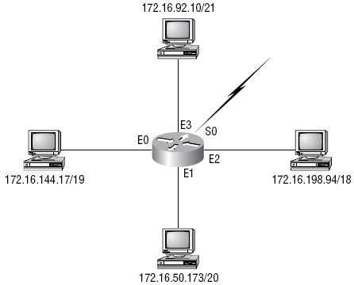
Case Study: Apply Extended ACL in Security Policy
We need to stop Telnet access to the networks attached to the Ethernet 1 and Ethernet 2
How do you solve this?

Slide 23
Answer to the last slide
Router(config)#access-list 110 deny tcp any 172.16.48.0 0.0.15.255 eq 23
Router(config)#access-list 110 deny tcp any 172.16.192.0 0.0.63.255 eq 23
Router(config)#access-list 110 permit ip any any
Router(config)#interface Ethernet 1
Router(config-if)#ip access-group 110 out
Router(config-if)#interface Ethernet 2
Router(config-if)#ip access-group 110 out

Slide 24
Creating Named ACLs - 1
A named ACL is created with the ip access-list command.
The advantages that a named access list provides are:
Intuitively identify an ACL using an alphanumeric name.
Eliminate the limit of 798 simple and 799 extended ACLs
Named ACLs provide the ability to modify ACLs without deleting and then reconfiguring them.
It is important to note that a named access list will allow the deletion of statements but will only allow for statements to be inserted at the end of a list. Even with named ACLs it is a good idea to use a text editor to create them.
Consider the following before implementing named ACLs.
Named ACLs are not compatible with Cisco IOS releases prior to Release 11.2.
The same name may not be used for multiple ACLs. For example, it is not permissible to specify both a standard and extended ACL named George.

Slide 25

Creating Named ACLs (Standard)
IP named ACLs were introduced in Cisco IOS Software Release 11.2, allowing standard and extended ACLs to be given names instead of numbers.
continue

Slide 26
Placing Name ACLs
Same as standard ACL and extended ACL
Using ip access-group command

Slide 27
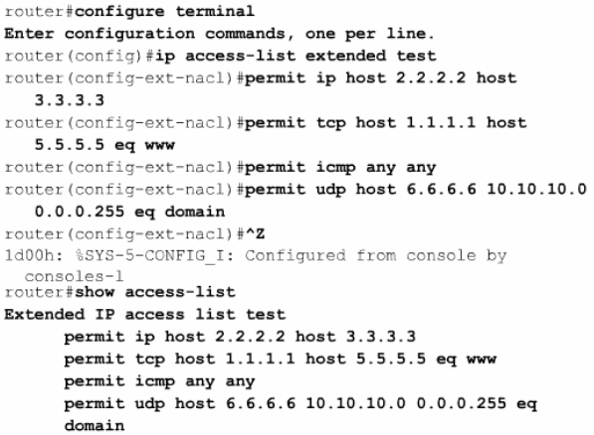
Creating Named ACLs – Extended -1

Slide 28
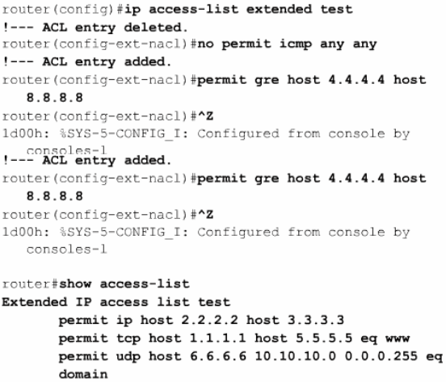
Creating Named ACLs – Extended -2

Slide 29
Inserting a line in Named ACL - 1

Slide 30
Inserting a line in Named ACL - 2

Slide 31
Summary: IP Standard and Extended List
IP Standard access lists
These use only the source IP address in an IP packet as the condition test.
All decisions are made based on source IP address. This means that standard access lists basically permit or deny an entire suite of protocols.
They don’t distinguish between any of the many types of IP traffic such as WWW, Telnet, UDP, etc.
IP Extended access lists
Extended access lists can evaluate many of the other fields in the layer 3 and layer 4 headers of an IP packet.
They can evaluate source and destination IP addresses, the protocol field in the Network layer header, and port number at the Transport layer header.
This gives extended access lists the ability to make much more granular decisions when controlling traffic.

Slide 32
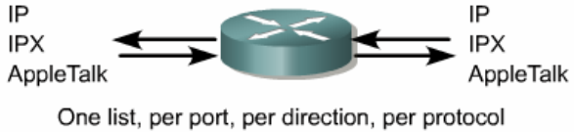
Access-List Grouping in a Router
ACLs must be defined on a per-protocol, per direction, or per port basis.
To control traffic flow on an interface, an ACL must be defined for each protocol enabled on the interface.
ACLs control traffic in one direction at a time on an interface.
A separate ACL would need to be created for each direction, one for inbound and one for outbound traffic.
Finally every interface can have multiple protocols and directions defined.
If the router has two interfaces configured for IP, AppleTalk, and IPX, 12 separate ACLs would be needed.
One ACL for each protocol, times two for direction in and out, times two for the number of ports.

Slide 33
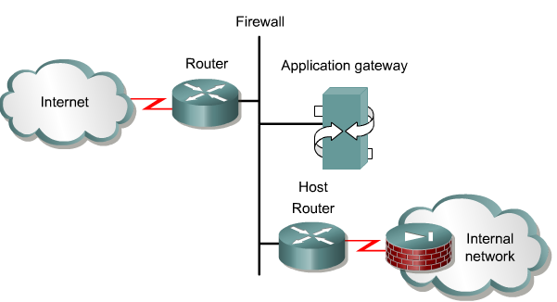
ACL and Firewall
A firewall is an architectural structure that exists between the user and the outside world to protect the internal network from intruders.

Slide 34
Other Uses of ACLs
Blocking Routing Protocols Advertisement.
Limit network traffic and increase network performance. By restricting video traffic, for example, ACLs could greatly reduce the network load and consequently increase network performance.
Provide traffic flow control. ACLs can restrict the delivery of routing updates. If updates are not required because of network conditions, bandwidth is preserved.
Provide a basic level of security for network access. ACLs can allow one host to access a part of the network and prevent another host from accessing the same area. For example, Host A is allowed to access the Human Resources network and Host B is prevented from accessing it.
Decide which types of traffic are forwarded or blocked at the router interfaces. Permit e-mail traffic to be routed, but block all telnet traffic.
Allow an administrator to control what areas a client can access on a network.
Screen certain hosts to either allow or deny access to part of a network. Grant or deny user permission to access only certain types of files, such as FTP or HTTP.
If ACLs are not configured on the router, all packets passing through the router will be allowed onto all parts of the network.

Slide 35
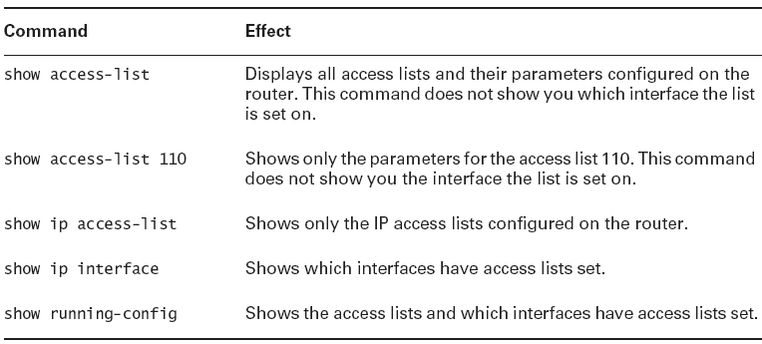
Summary: Monitoring ACL

Slide 36
Summary: Application of ACL
ACL can
deny unwanted access to the network or LAN
permit certain user to access to the network
deny internal users of a LAN to access certain services.
permit internal user to access only certain services
Security tools, such as passwords, callback equipment, host software firewall, and physical security devices are helpful, however
they lack the flexibility of basic traffic filtering and the specific controls at the LAN level.
For example, a network administrator
may want to allow LAN users access to the Internet,
but not permit external users telnet access into the LAN.
Some form of firewall mechanism or packet filtering has to be carried at the router/LAN level.

Slide 37
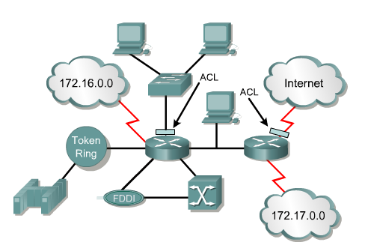
Summary: ACL at Router Interface
ACLs are lists of conditions that are applied to traffic traveling across a router's interface.
These lists tell the router what types of packets to accept or deny at the Interface.
ACLs can be created for all routed network protocols, such as Internet Protocol (IP) and Internetwork Packet Exchange (IPX). ACLs can be configured at the router to control access to a network or subnet.

Slide 38
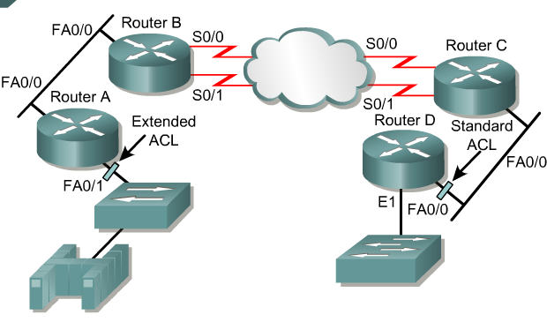
Summary: Placing ACLs
The general rule is to put the extended ACLs as close as possible to the source of the traffic denied.
Standard ACLs do not specify destination addresses, so they should be placed as close to the destination as possible.

Slide 39
Summary: How ACL “Logic” Works
An ACL is a group of statements that define whether packets are accepted or rejected at inbound and outbound interfaces.
These decisions are made by matching a condition statement in an access list and then performing the accept or reject action defined in the statement.
The order in which ACL statements are placed is important.
The Cisco IOS software tests the packet against each condition statement in order from the top of the list to the bottom.
Once a match is found in the list, the accept or reject action is performed and no other ACL statements are checked.
If a condition statement that permits all traffic is located at the top of the list, no statements added below that will ever be checked.

